Slide 1
TOPIC - RATIOS, PROPORTIONS & UNITARY METHOD

Slide 2
LEARNING OBJECTIVES:-
After learning the chapter, student will be able to:
(a) understand the concepts of ratio .
(b)know how to determine ratio .
(c)understand the concepts of proportion .
(d)understand how to determine proportion.
(e)know how to apply ratio and proportion to solve the real life problems.
(f)know how to use the unitary method to solve the problems.

Slide 3
INTRODUCTION
Comparing two quantities by division is called ratio. In our day to daily life we compare between so many things, these are nothing but the ratio between them.

Slide 4
A statement of equality of ratios is called proportion. It is nothing but the application part of Ratio.
The Unitary method is a technique for solving a problem by first finding a single unit, then finding the necessary value by multiplying the single unit value. This method is very necessary to solve our Daily life problems.

Slide 5
COMPARING OF NUMBERS
GROUP-A
GROUP-B

Slide 6
5
3
2
(I) BY FINDING DIFFERENCE:
GROUP–A HAS 2 BOYS MORE THAN GROUP-B
5
VIDEO FOR BETTER UNDERSTANDING OF THE CONCEPT
(II) BY DIVIDING NUMBERS:
3
GROUP–A IS 5/3 TIMES OF GROUP-B.

Slide 7
RATIOS
COMPARING TWO QUANTITIES BY DIVISON IS CALLED RATIO.
For Example:
There are 5 boys in Group-A and 3 boys in Group-B
The ratio of Group-A to Group-B is 5 to 3.
-The ratio of 5 to 3 is denoted as 5 : 3 and is read as ‘Five is to Three’.
-In the ratio 5 is called first term or Antecedent.
and 3 is called second term or Consequent.

Slide 8
REPRESENTATION OF RATIO BY DIAGRAM
In the above figure, there are total 8 regions out of which 3 are shaded . So the ratio of the shaded region is 3 : 8

Slide 9
GUIDING PRINCIPLES WHILE FORMING A RATIO

Slide 10
The two quantities compared should be expressed in the same unit.
For Example:
Ratio of 2 m to 75 cm should be 200 cm to 75 cm.
The names or units of the two quantities should not be used in Ratio.
For Example:
Ratio of 200 cm to 75 cm should be 200 : 75. √ 200 cm : 75 cm

Slide 11
Two quantities which are compared must be in same kind. Different kinds of quantities can not be compared in Ratio.
For Example:
10 Rupees and 5 Pens cannot be compared.
Ratio should always be expressed in simplest form.
For Example:
5 : 10 should be written in the form of 1 : 2.

Slide 12
The order of term in Ratio is important.
For Example:
If ratio of boys to girls is 2 : 3 then the ratio of girls to boys is 3 : 2.

Slide 13
EXAMPLE:-
The ratio of the length of a vertical pole and its shadow on the ground is 7 : 2.Find the length of the pole if the length of the shadow is 2.4m.
ANSWER:-
Ratio of length of vertical pole and its shadow is 7 : 2.
So, the length of pole = 7m
Then the length of shadow =2m
Now, the length of shadow =2.4 m
New Length of pole=7 X (2.4 / 2) =8.4 m

Slide 14
PROPORTIONS
A STATEMENT OF EQUALITY OF RATIOS IS CALLED PROPORTION.
1
4
?
4
16
Are these ratios saying same thing?
?

Slide 15
PROPORTIONS
A STATEMENT OF EQUALITY OF RATIOS IS CALLED PROPORTION.
It means 1:4 = 4: 16
Such an equality of ratio is called Proportion.
The symbol used to denote proportion is ( : : )
i.e. 1: 4 : : 4 : 16
It has been read as
1 is to 4 as 4 is to 16
1
4
=
4
16
Yes these ratios are saying same thing.

Slide 16
PROPORTIONS
The numbers 1, 4, 4 and 16 are called the terms of the Proportion.
1st Term
2nd Term
3rd Term
4th Term
1 : 4 : : 4 : 16
Means
Extremes
Product of means = 4x4=16
Product of Extremes= 1x16=16
This property helps to check the terms are in proportion.
Same

Slide 17
EXAMPLE
If a men runs at a speed of 20 km in 2 hours then with the same speed would he be able to cross 40 km in 4 hours.
ANSWER:
Here the ratio of the distances given is 20/40 = 1/2 =1:2
The ratio of the time taken by them also 2/4=1/2=1:2
Hence, the four numbers are in proportion. We can write them in proportion as
20 : 40 :: 2 : 4 and read as 20 is to 40 as 2 is to 4

Slide 18
EXAMPLE
Check the respective terms 30, 99, 20, 66 are in proportion or not.
ANSWER:
30 and 66 are extreme terms.
99, 20 are middle terms.
These are in proportion if the product of extremes must be equal to product of means.
So, 30X66=1980 and 99X20 =1980
So, these terms are in proportion.

Slide 19
CONTINUED PROPORTION:-
Three quantities are said to be in continued proportion, if the ratio between the first and the second is equal to the ratio between the second and the third.
That is a , b and c are in continued proportion , if a : b = b :c

Slide 20
EXAMPLE:-
Check 6, 12 and 24 are in continued proportion or not .
ANSWER:-
The ratio of first quantity to the second is = 6 : 12= 1 : 2
The ratio of the second quantity to the third quantity
= 12 : 24 = 1 : 2
We see that 6 : 12 = 12 : 24
Thus, 6, 12, 24 are in continued proportion .

Slide 21
UNITARY METHOD
The unitary method is a technique for solving a problem by first finding the value of a single unit, and then finding the necessary value by multiplying the single unit value.
In essence, this method is used to find the value of a unit from the value of a multiple, and hence the value of a multiple.

Slide 22
EXAMPLE
If the cost of 3 books is Rs 320 .Then what will be the cost of 6 books.
ANSWER:
Cost of 3 books = Rs 320
Cost of 1 book =Rs 320/3
Cost of 6 books=Rs 320/3X6=Rs 640.
Hence, the cost of 6 books is Rs 640.

Slide 23
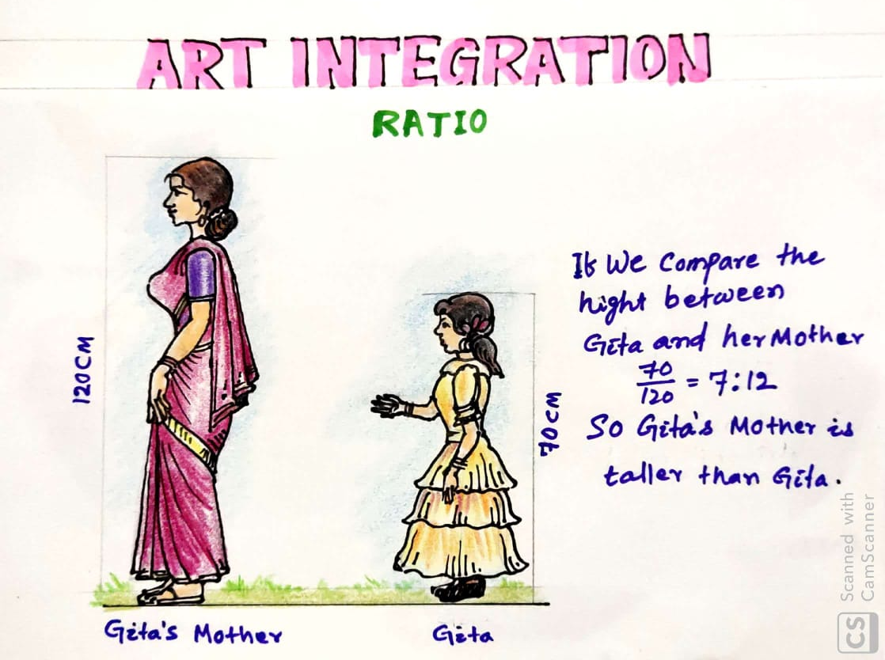

Slide 24
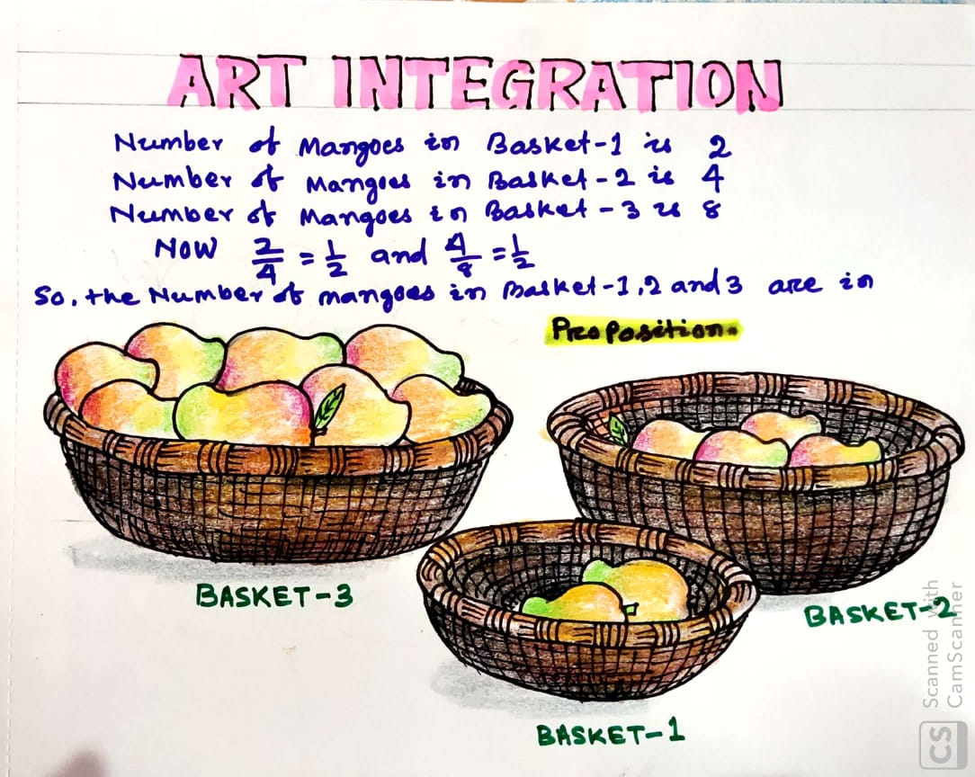

Slide 25
ACTIVITIES:-
ACTIVITY-1
Take the height of your father and mother, then by using ratio tell that who is taller.
ACTIVITY-2
Take the number of pages present in your Mathematics, Science and Social Science books, then tell that the number of pages are proportion or not.

Slide 26
CONCEPT MAPPING
RATIO
COMPARING TWO QUANTITIES BY DIVISON
PROPORTION
A STATEMENT OF EQUALITY OF RATIOS
UNITARY METHOD
THE VALUE OF SINGLE UNIT
In the ratio first term is called Antecedent and second term is called Consequent.
The two quantities compared should be expressed in the same unit.
The names or units of the two quantities should not be used in Ratio.
Two quantities which are compared must be in same kind. Different kinds of quantities can not be compared in Ratio.
Ratio should always be expressed in simplest form.
The order of term in Ratio is important.
The numbers are called the terms of the Proportion.
The first and fourth term are called Extremes.
The second and third terms are called means.
The product of means and extremes are always same in a true proportion.
Finding the value of a single unit.
Then find the value of a multiple.

Slide 27
Thank you

